Slide 1


Muhib Zaman
Feb 28, 2024

Slide 2
Outline
Executive Summary
Introduction
Methodology
Results
Conclusion
Appendix

Slide 3
Executive Summary
Summary of methodologies
Data collection through API and web scraping
Data wrangling
Exploratory data analysis (EDA) with data visualization and SQL
Interactive visuals with Folium and Plotly Dash
Machine Learning Prediction
Summary of all results
Exploratory data analysis results
Interactive analytics demo in screenshots
Predictive analysis results

Slide 4
Introduction
Project background and context
SpaceX advertises Falcon 9 rocket launches on its website for $62 million, significantly less than other providers whose costs exceed $165 million each. This substantial cost savings is attributed to SpaceX's ability to reuse the first stage of the rocket. Thus, predicting the successful landing of the first stage is crucial in estimating the launch cost. The project aims to develop a machine learning pipeline to predict if the 1st stage will land successfully.
Problems you want to find answers
What is the impact of impact of Payload Mass, Launch Site, Flight Frequency, and Orbits on first-stage landing success?
What is the trend of successful landing over time?
What is best predictive model for successful landing?

Slide 5

Section 1

Slide 6
Methodology
Executive Summary
Data collection methodology: Data was collected through a combination of using the SpaceX API and scraping information Wikipedia
Perform data wrangling: Filtered, handled missing values, and applied one hot-encoding to categorical features
Perform exploratory data analysis (EDA) using visualization and SQL
Perform interactive visual analytics using Folium and Plotly Dash
Perform predictive analysis using classification models

Slide 7
Data Collection
Collected data using get request from SpaceX API
Decoded the data using .json() and converted into a Pandas dataframe using .json_normalize()
Collected additional data points from SpaceX API using custom functions
Created dictionary from data and created dataframe from the dictionary
Filtered dataframe to display only Falcon 9 launches
Replaced missing values for PayLoadMass/LandingPad

Slide 8
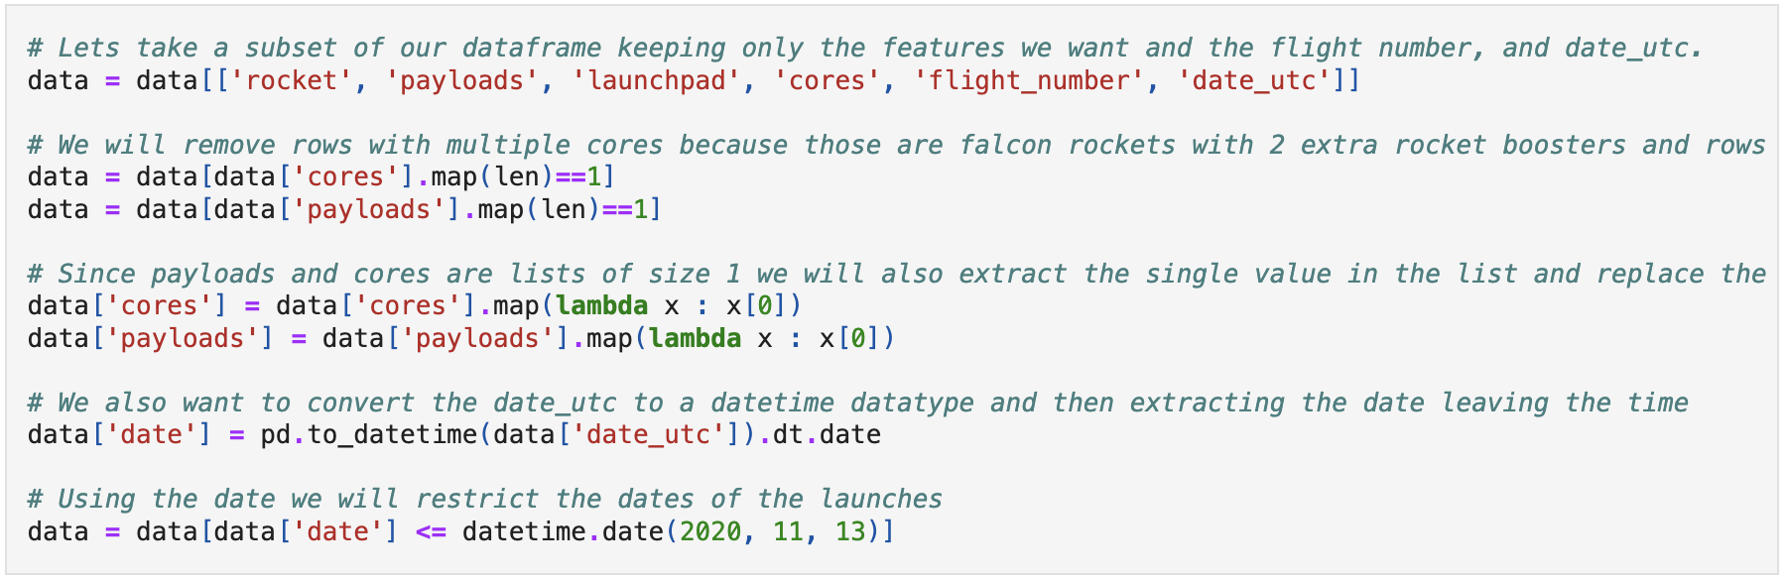
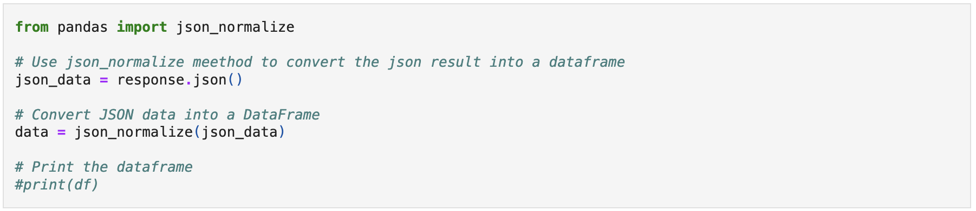
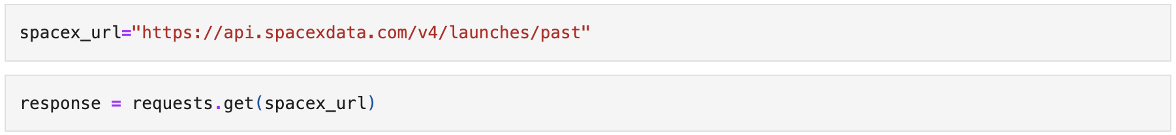
Data Collection – SpaceX API
Collected data using get request from SpaceX API
Decoded the data using .json() and Converted into a Pandas dataframe using .json_normalize()
Collected additional data points from SpaceX API using custom functions
Created dictionary from data and Created dataframe from the dictionary
Filtered dataframe to display only Falcon 9 launches and Replaced missing values for PayLoadMass/LandingPad
GitHub link: https://github.com/mzr015/ds_capstone/blob/main/jupyter-labs-spacex-data-collection-api.ipynb

Slide 9
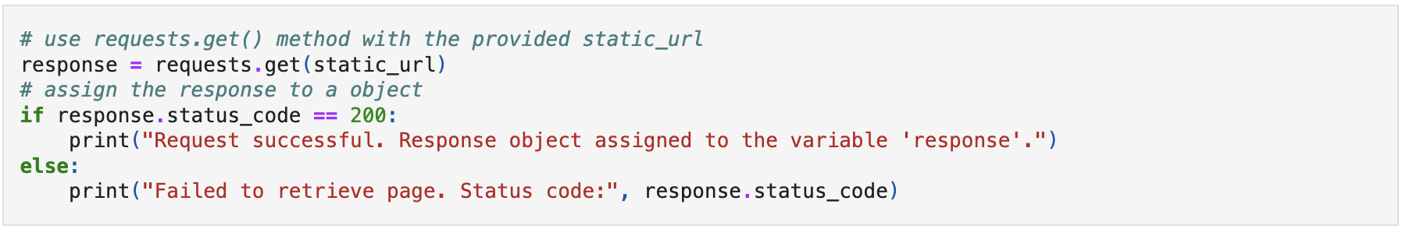
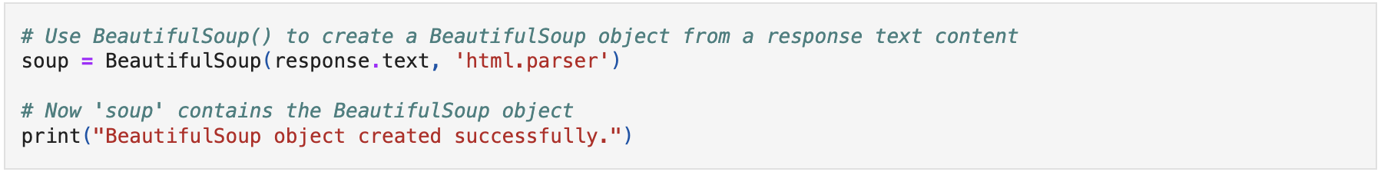
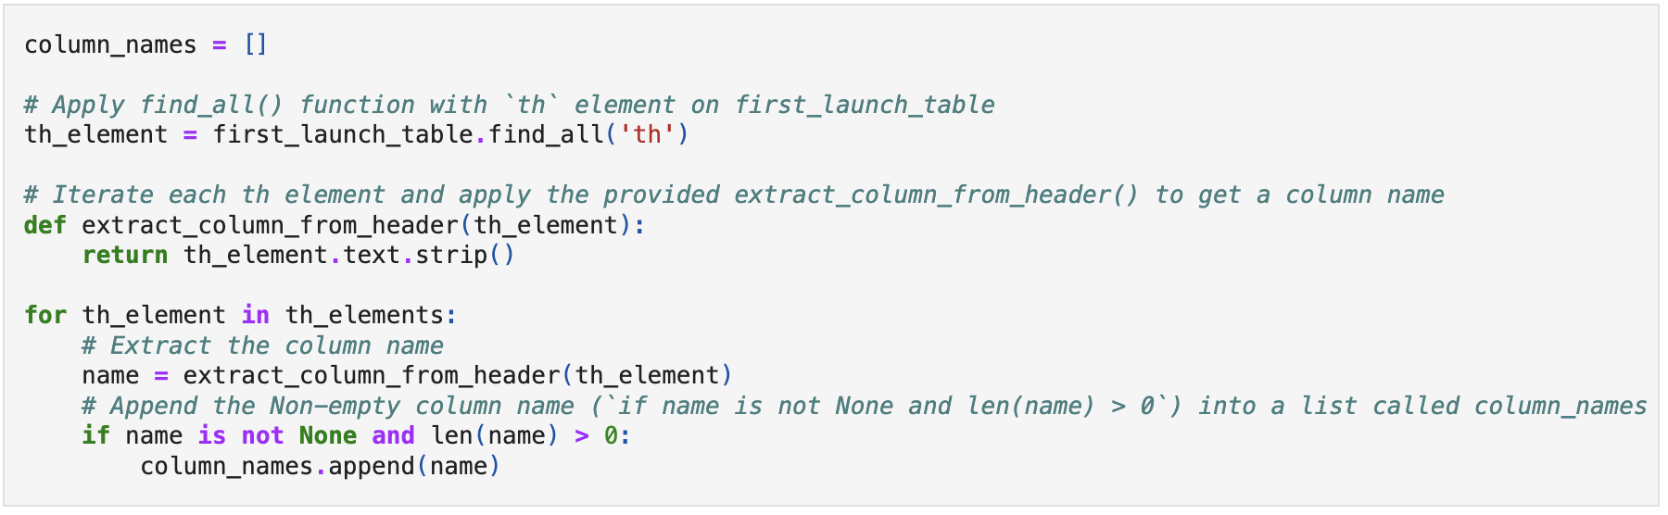
Data Collection - Scraping
Collected data for Falcon 9 launch using get request from Wikipedia
Created a BeautifulSoup object from the HTML response
Extracted all column from the HTML table header
Created a data frame by parsing the launch HTML tables
GitHub link: https://github.com/mzr015/ds_capstone/blob/main/jupyter-labs-webscraping.ipynb

Slide 10
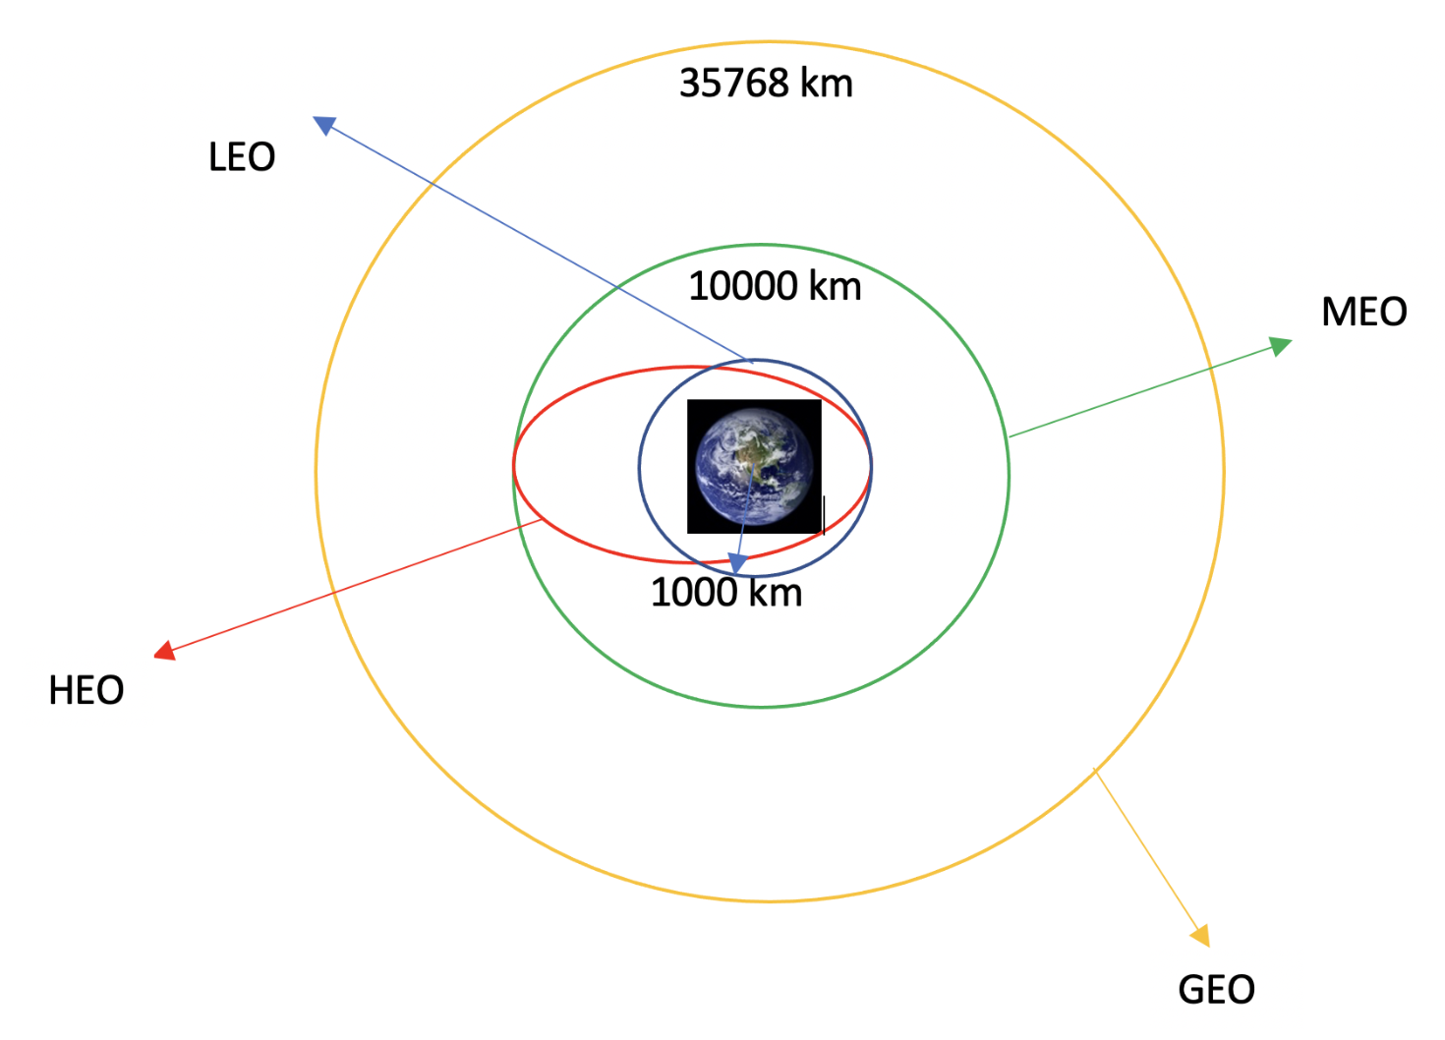
Data Wrangling
Performed exploratory data analysis and determined training labels
Calculated
the number of launches on each site
the number and occurrence of each orbit
the number and occurrence of mission outcome of the orbits
Created a landing outcome label from Outcome column
GitHub link: https://github.com/mzr015/ds_capstone/blob/main/labs-jupyter-spacex-Data%20wrangling.ipynb

Slide 11
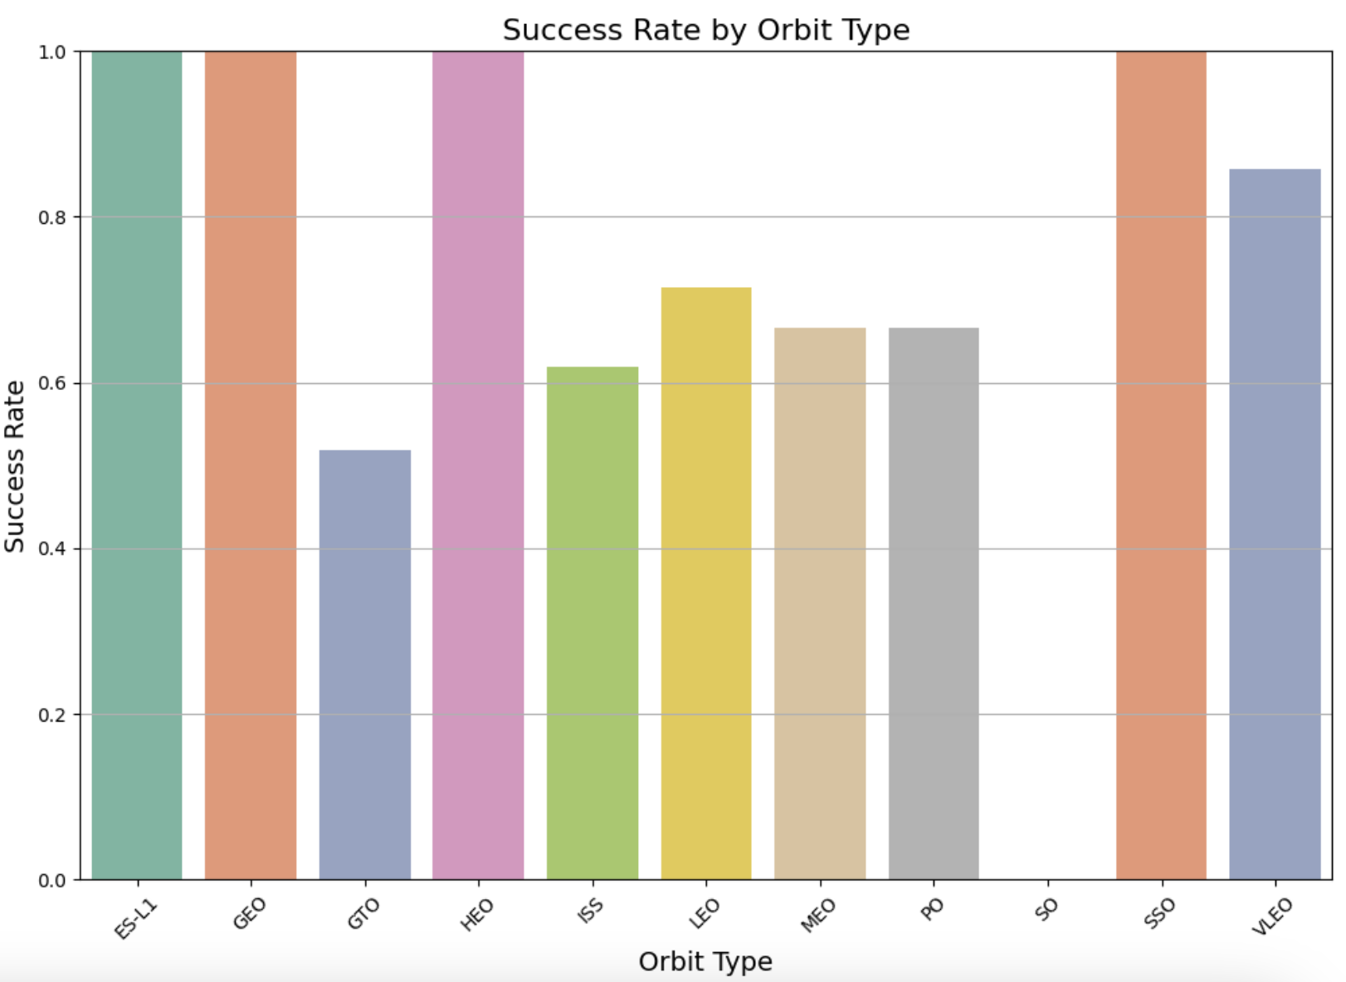
EDA with Data Visualization
Visualizations
Flight Number vs. Launch Site
Payload vs. Launch Site
Success Rate vs. Orbit Type
Flight Number vs. Orbit Type
Payload vs. Orbit Type
Launch Success Yearly Trend
GitHub Link: https://github.com/mzr015/ds_capstone/blob/main/jupyter-labs-eda-dataviz.ipynb

Slide 12
EDA with SQL
SQL Queries
All Launch Site Names
Launch Site Names Begin with 'CCA’
Total Payload Mass
Average Payload Mass by F9 v1.1
First Successful Ground Landing Date
Successful Drone Ship Landing with Payload between 4000 and 6000
Total Number of Successful and Failure Mission Outcomes
Boosters Carried Maximum Payload
2015 Launch Records
Rank Landing Outcomes Between 2010-06-04 and 2017-03-20
GitHub Link: https://github.com/mzr015/ds_capstone/blob/main/jupyter-labs-eda-sql-coursera_sqllite.ipynb

Slide 13
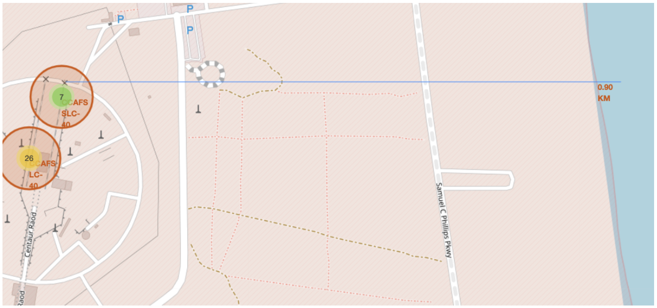
Build an Interactive Map with Folium
Map objects:
Markers: To pinpoint each launch site’s locations on the map.
Circles: To highlight each launch site’s general areas.
Marker Clusters: To handle multiple markers with the same coordinates
Polyline: To represent the distances between launch sites and various proximities such as coastlines.
GitHub Link: https://github.com/mzr015/ds_capstone/blob/main/lab_jupyter_launch_site_location.ipynb

Slide 14
Build a Dashboard with Plotly Dash
Pie Chart (Success vs. Failure):Displays the total count of successful and failed launches.
Interaction: Users can select a specific launch site from the dropdown menu, and the pie chart dynamically updates to show the success vs. failure counts for the selected site.
Purpose: Provides users with an overview of the success rate for SpaceX launches across different sites.
Scatter Plot (Mission Outcomes vs. Payload Mass): shows the relationship between payload mass and launch outcomes (success or failure).
Interaction: Users can select a launch site from the dropdown menu and adjust the payload range using the slider.
Purpose: This plot allows users to explore how payload mass may affect the success or failure of SpaceX launches at different sites. It also helps identify any correlations between payload mass and mission outcomes.
GitHub Link: https://github.com/mzr015/ds_capstone/blob/main/spacex_dash_app.py

Slide 15
Predictive Analysis (Classification)
Data Preparation:
Loaded and explored the dataset.
Standardized the features and split the data into training and testing sets.
Model Building:
Utilized Logistic Regression, SVM, Decision Tree, and KNN algorithms.
Tuned hyperparameters using GridSearchCV.
Evaluation:
Calculated accuracies on the test data.
Visualized performance with confusion matrices.
Selection:
Identified the best model based on max accuracy
GitHub Link: https://github.com/mzr015/ds_capstone/blob/main/SpaceX_Machine_Learning_Prediction_Part_5.ipynb

Slide 16
Results
Exploratory data analysis results
Success rate has increased over time
Orbits ES-L1, GEO, HEO, SSO have a 100% success rate
KSC LC 39A is most successful launching site
Interactive analytics demo in screenshots
All launch sites are close to coastlines
They are generally far away from cities, highways, and other infrastructures
Predictive analysis results
Decision Tree Classifier is the best predictive model (score: 0.88571)

Slide 17

Section 2

Slide 18
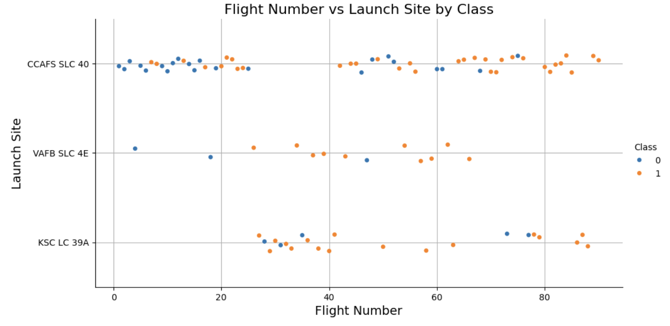
Flight Number vs. Launch Site
The analysis revealed that launch sites with higher flight frequencies tend to exhibit higher success rates.

Slide 19
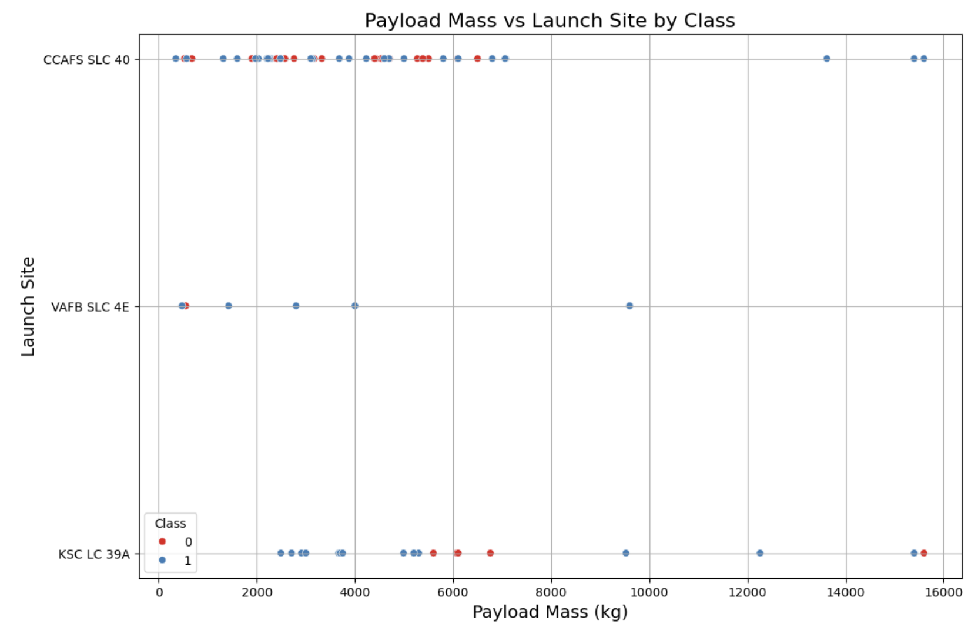
Payload vs. Launch Site
The higher the payload mass (kg), the higher the success rate

Slide 20
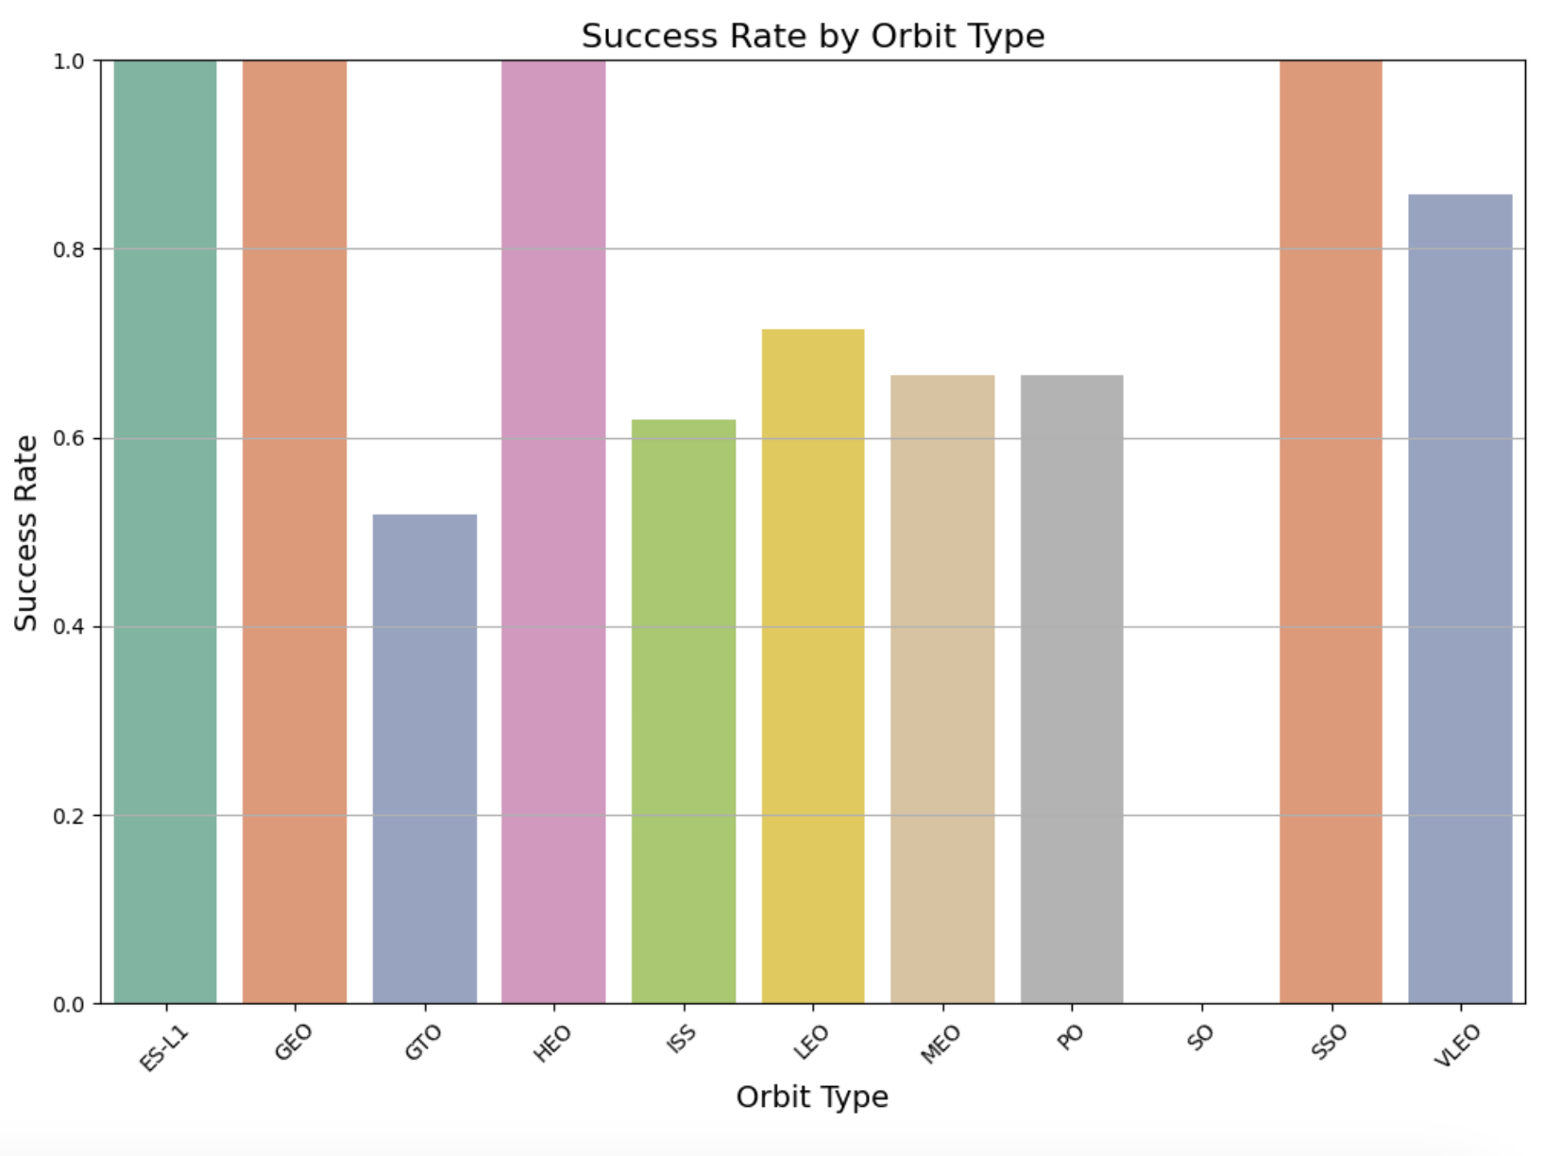
Success Rate vs. Orbit Type
Orbits ES-L1, GEO, HEO, SSO have a 100% success rate
Orbit SO has 0% success rate
The rest have success rates between 50%-85%

Slide 21
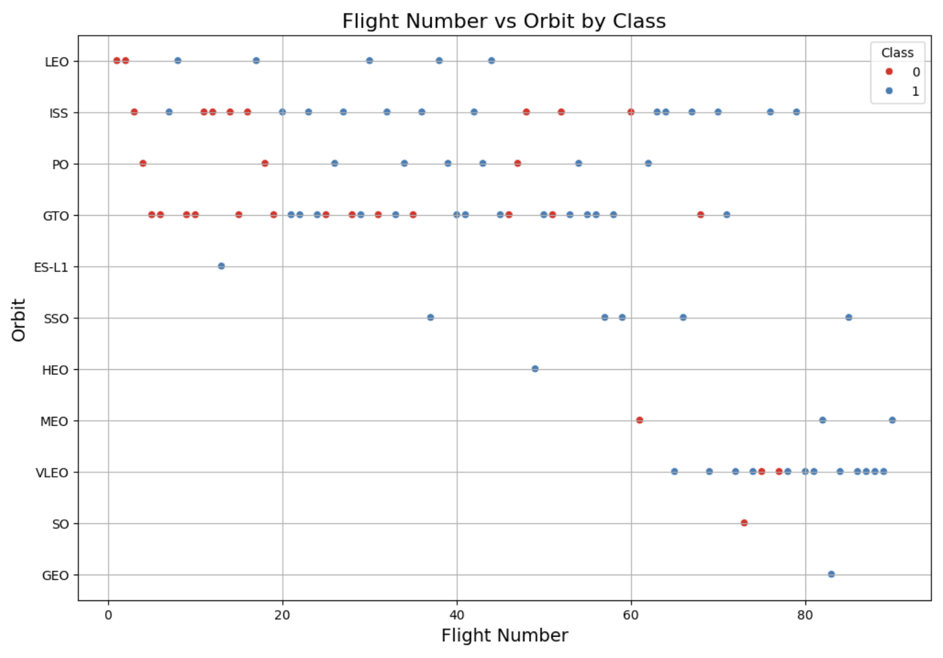
Flight Number vs. Orbit Type
The success rate typically rises with the number of flights in each orbit. In LEO, success correlates with the frequency of flights. However, GTO does not follow this trend.

Slide 22
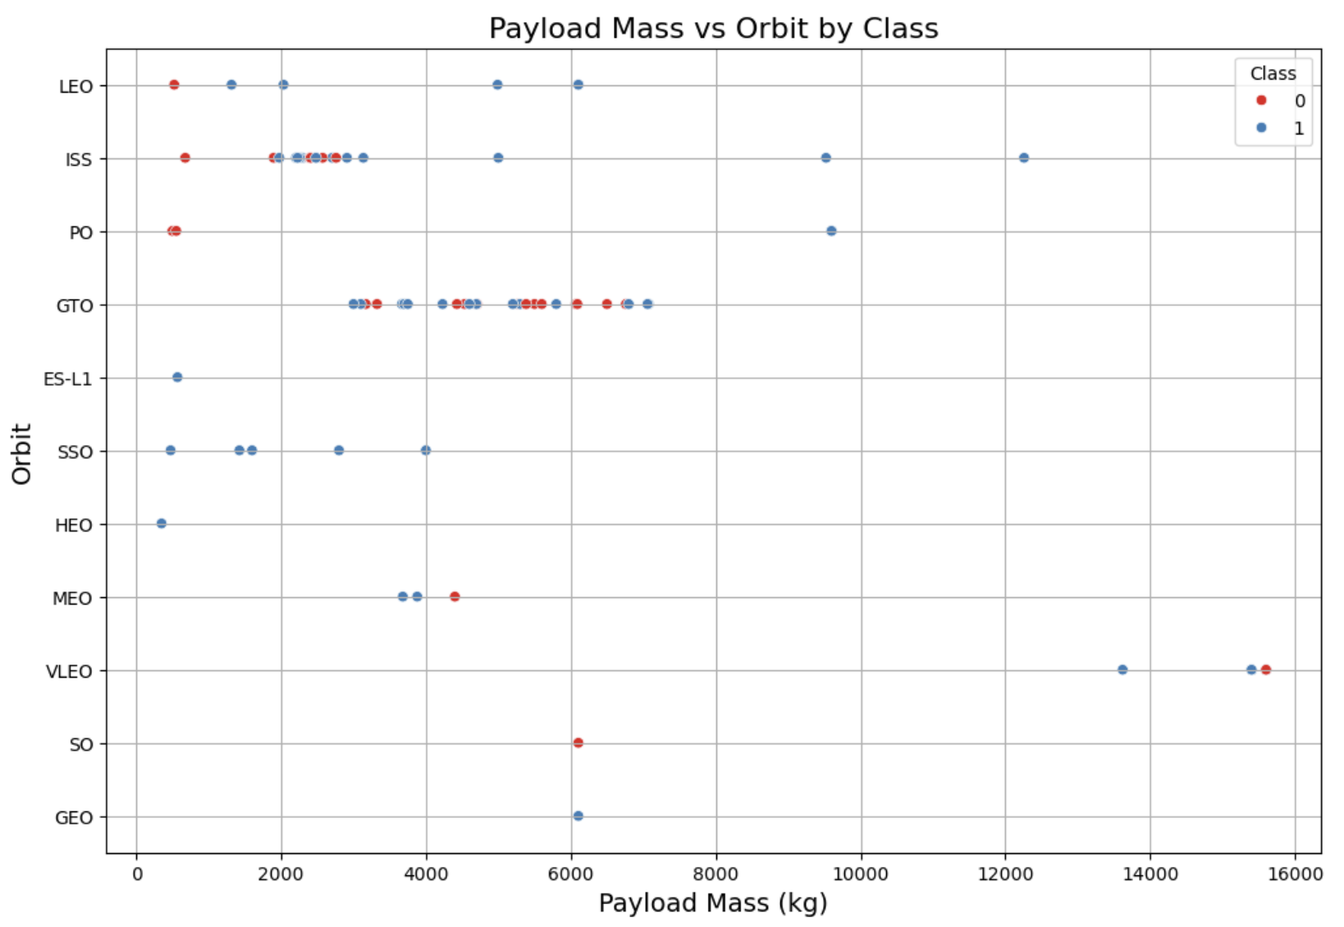
Payload vs. Orbit Type
Heavier payloads result in more successful landings for PO, LEO, and ISS orbits.

Slide 23
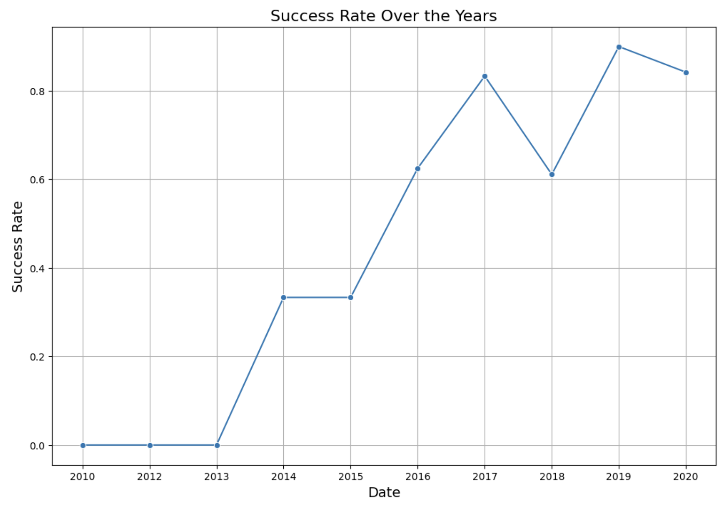
Launch Success Yearly Trend
Success rate has steadily increased from 2013 to 2020

Slide 24
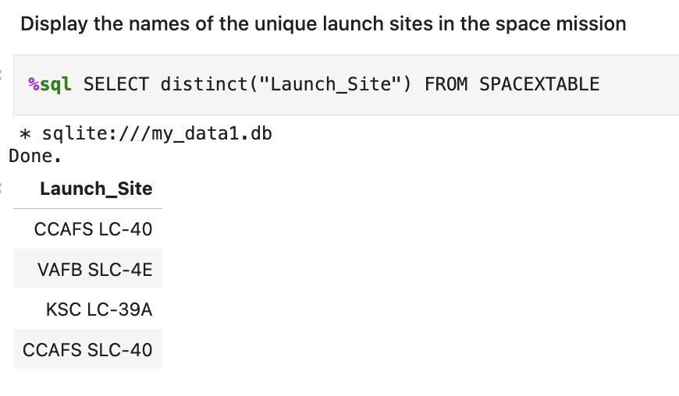
All Launch Site Names
Used the query to find all unique launch site names

Slide 25
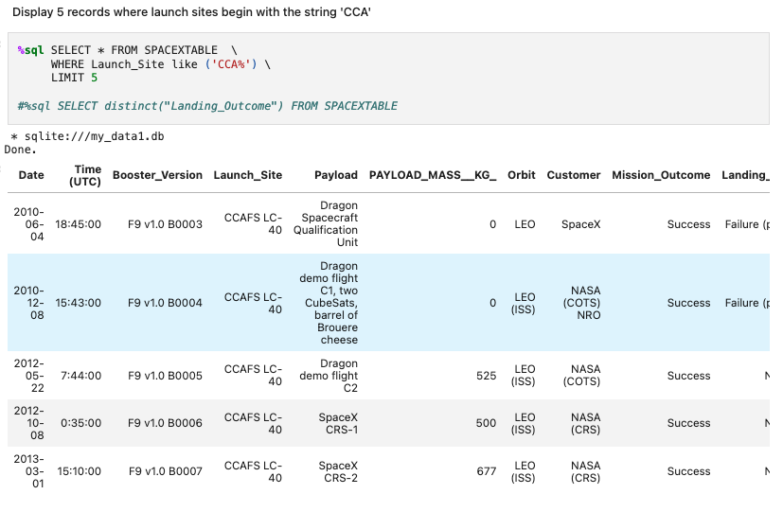
Launch Site Names Begin with 'CCA'
Used the query to find all launch site names that begins with ‘CCA’ and limited the result to 5

Slide 26
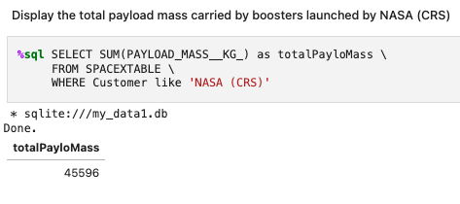
Total Payload Mass
Used the query to compute the total payload carried by boosters from NASA, resulting in a total of 45,596

Slide 27
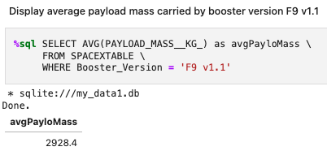
Average Payload Mass by F9 v1.1
Used the query to compute the average payload carried by booster version F9 v1.1, resulting in a total of 2928.4

Slide 28
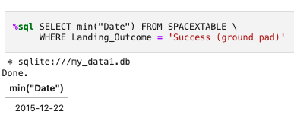
First Successful Ground Landing Date
Used the query to identify the date of the first successful ground landing, which occurred on December 22nd, 2015.

Slide 29
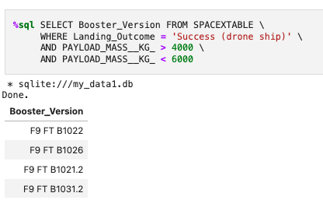
Successful Drone Ship Landing with Payload between 4000 and 6000
Used the query to identify successful landing with payload mass greater than 4000 but less than 6000

Slide 30
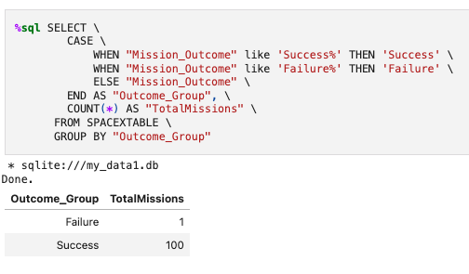
Total Number of Successful and Failure Mission Outcomes
Used the query to calculated the total number of successful (100) and failure (1) mission outcomes

Slide 31
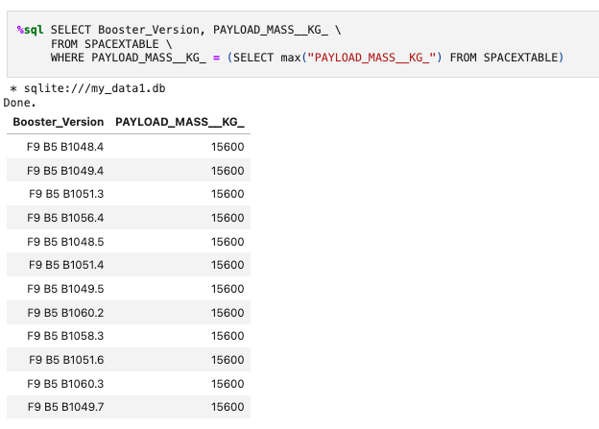
Boosters Carried Maximum Payload
Used the query to identify the boosters that have carried the maximum payload

Slide 32
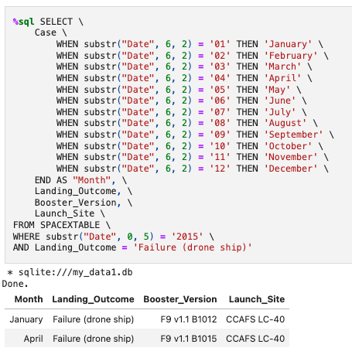
2015 Launch Records
Used the query to filter for failed landing outcomes in drone ship, their booster versions, and launch site names for year 2015

Slide 33
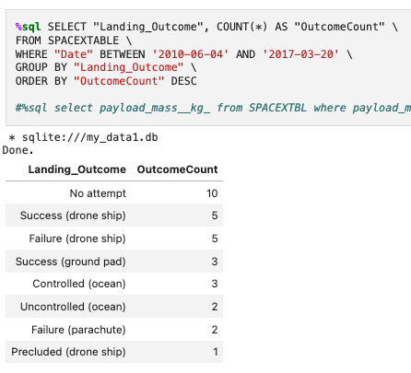
Rank Landing Outcomes Between 2010-06-04 and 2017-03-20
Used the query to filter for landing outcomes BETWEEN 2010-06-04 to 2010-03-20 and then ranked by count

Slide 34

Section 3

Slide 35
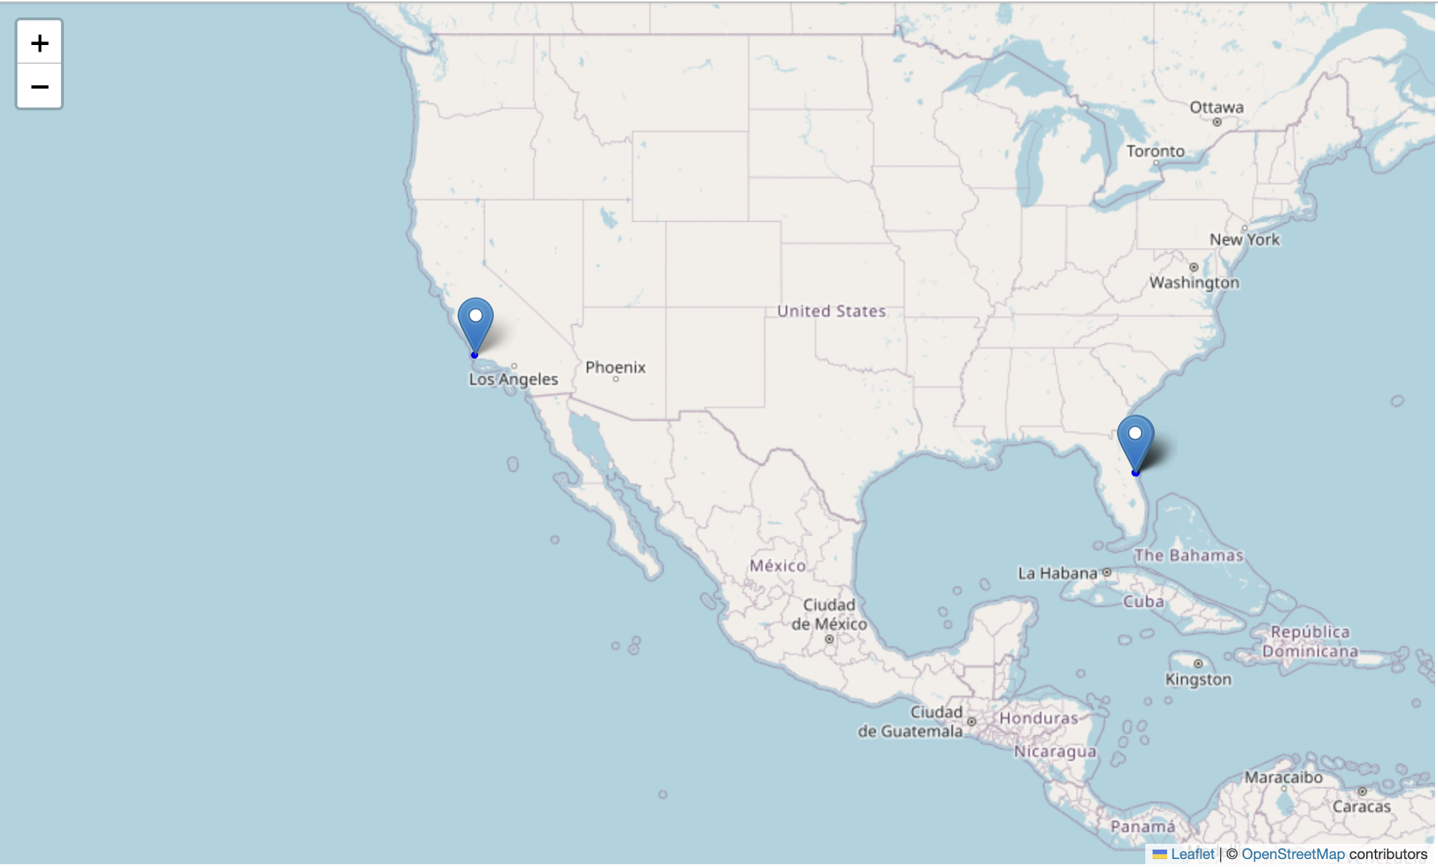
Launch Sites
The launch sites are situated on the coast of the United States, with one in California and the other in Florida.

Slide 36
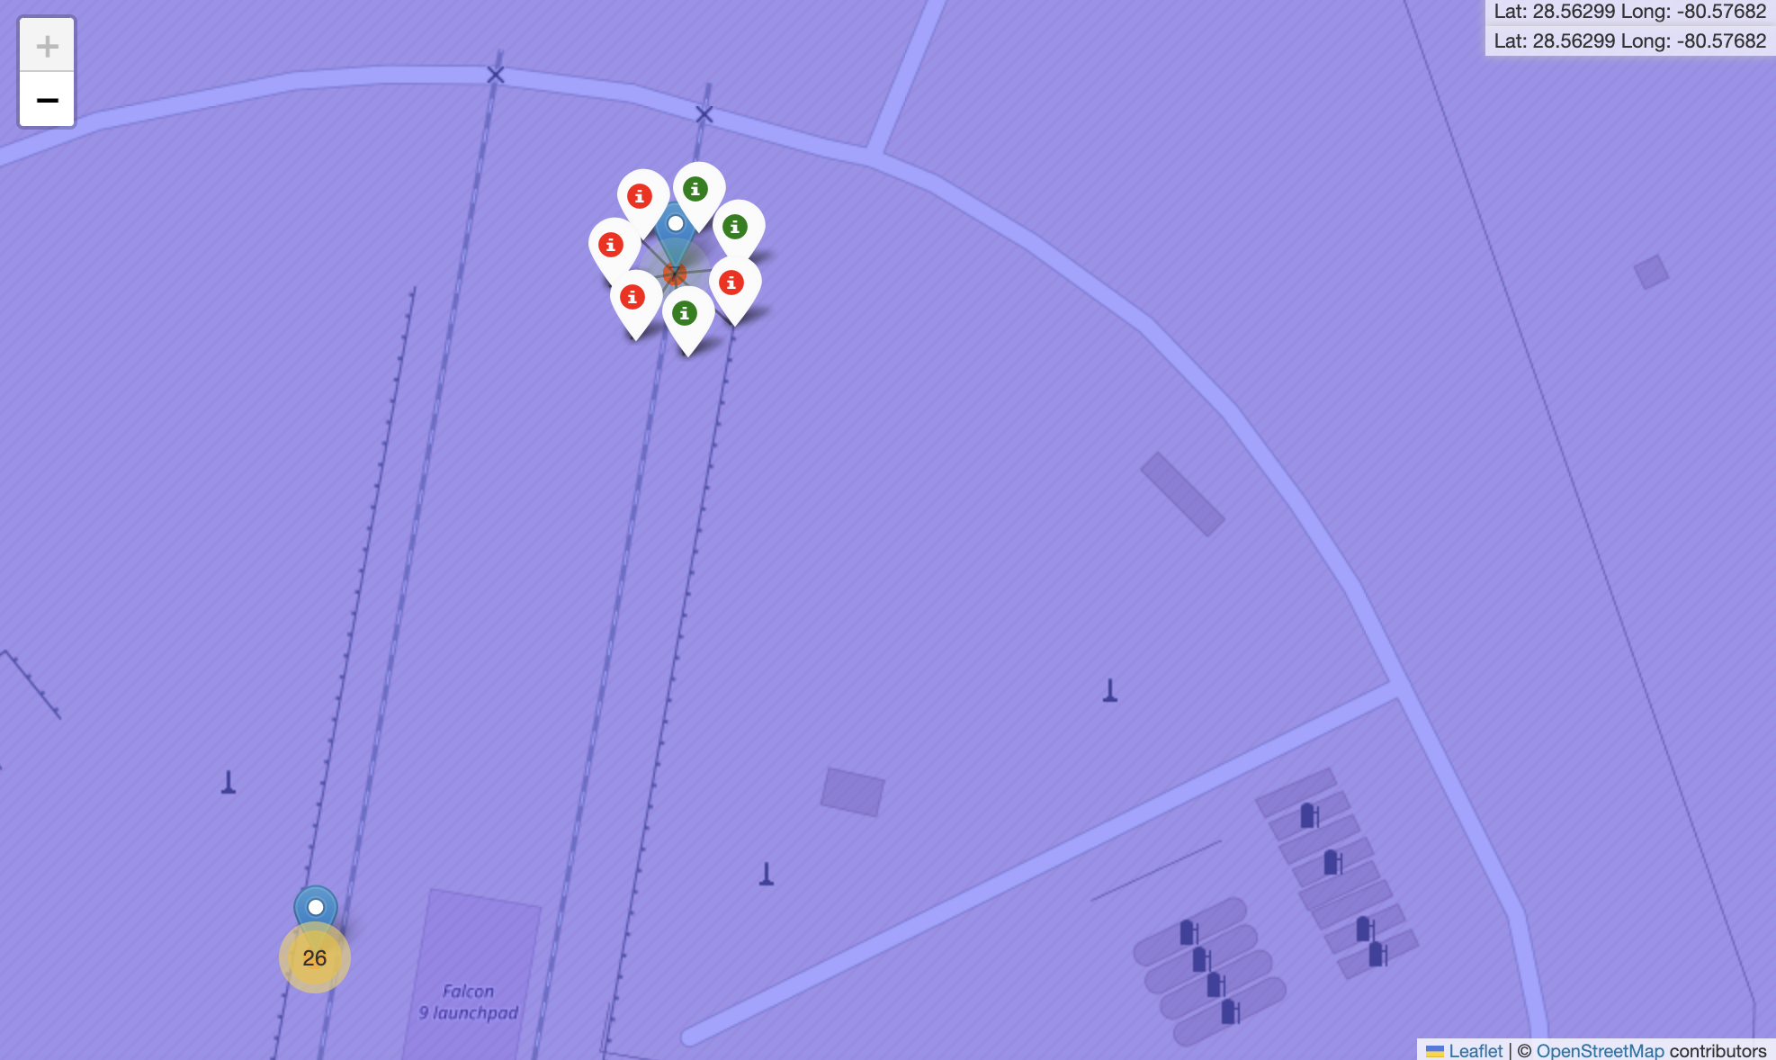
Launch Outcomes
Green: Successful launches
Red: Failed Launches
CCAFS SLC-40: 3 successful launches out of 7
CCAFS LC-40: 7 successful launches out of 26
KSC LC-39A: 10 successful launches out of 13
VAFB SLC-4E: 4 successful launches out of 10

Slide 37
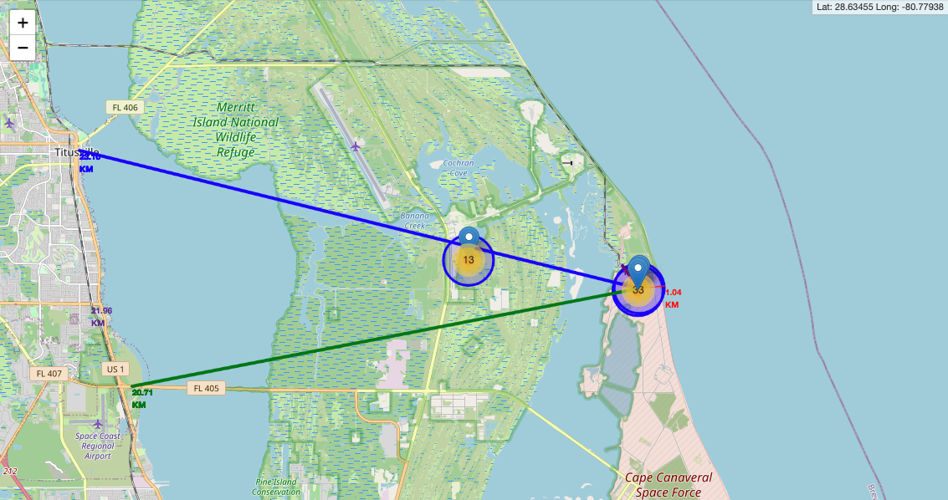
Distance to Proximities
Distance to closest coastline: 1.04 KM
Distance to closest city: 23.10 KM
Distance to closest highway: 20.71 KM
Distance to closest railway: 1.11 KM

Slide 38

Section 4

Slide 39
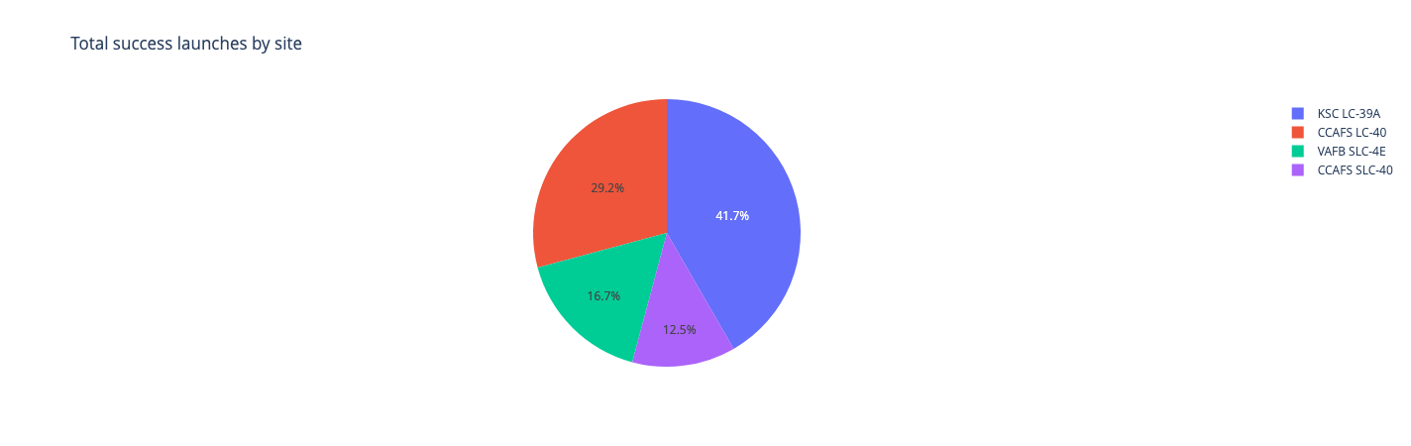
Launch Success by Site
KSC LC-39A has the highest success rate (41.7%) among all launch sites

Slide 40
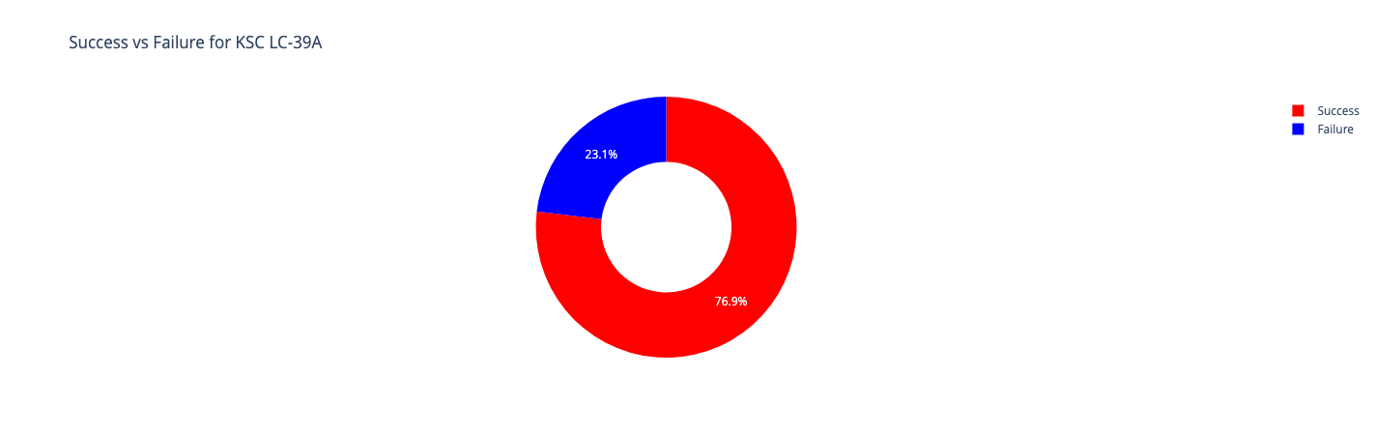
Success Ratio of
KSC LC-39A
KSC LC-39A has a success ratio of 76.9%

Slide 41
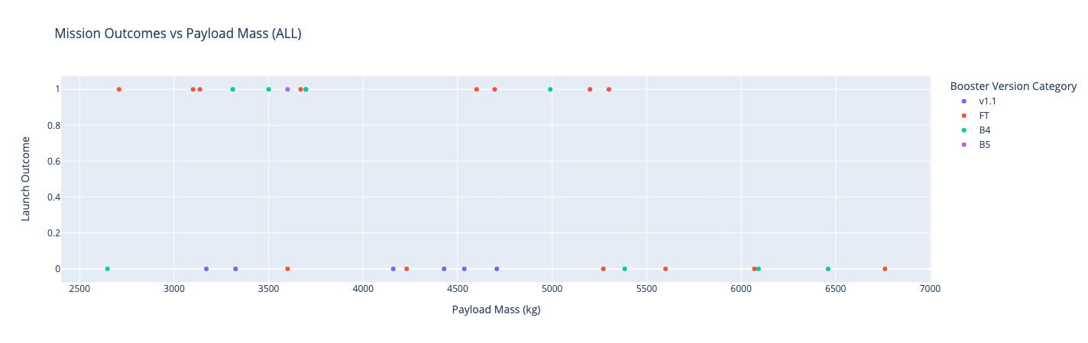
Payload Mass vs. Launch Outcome
Payloads with lower weight (2000 kg to 5000 kg) has a higher success rate compared to heavier payloads.

Slide 42

Section 5

Slide 43
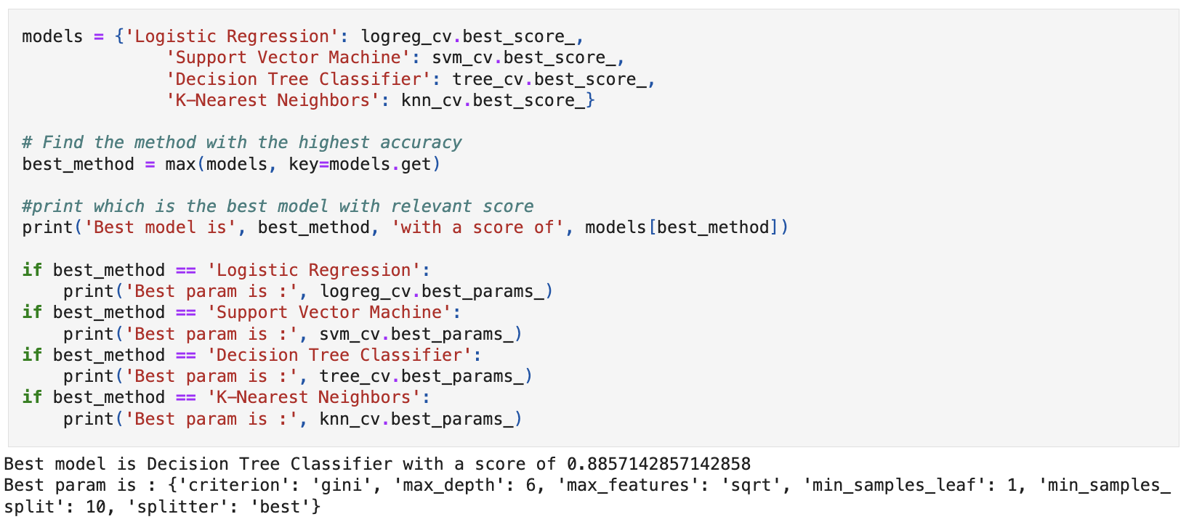
Classification Accuracy
According to this analysis, Decision Tree Classifier is the best model (with a score of 0.88571) for prediction

Slide 44
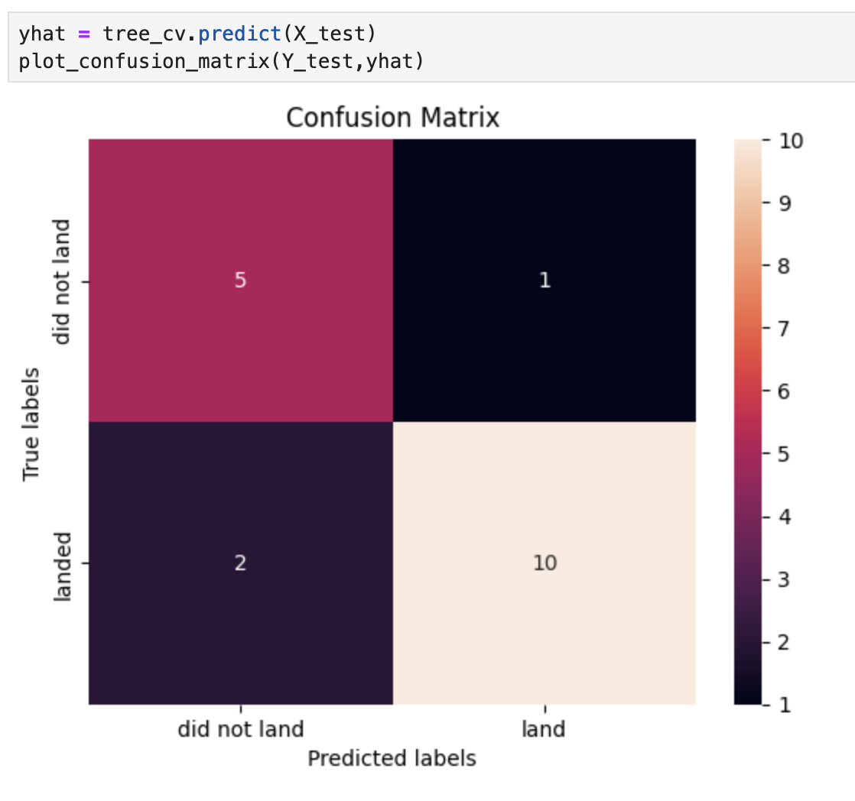
Confusion Matrix
Confusion Matrix Outputs:
10 True positive
1 True negative
5 False positive
2 False Negative
Precision = TP / (TP + FP) = 10 / 15 = 0.67
Recall = TP / (TP + FN) = 10 / 12 = 0.83
F1 Score = 2 * (Precision * Recall) / (Precision + Recall)= 2 * (.67 * .83) / (.67 + .83) = .74
Accuracy = (TP + TN) / (TP + TN + FP + FN) = .61

Slide 45
Conclusions
Model Performance: The models exhibited similar performance on the test set, with the decision tree model showing slight superiority.
Coastal Location: All launch sites are located in close proximity to coastlines, facilitating easier access and logistics for launching.
Launch Success Trend: There is a noticeable increase in launch success rates since 2013.
KSC LC-39A: Among all launch sites, KSC LC-39A stands out with the highest success rate. Notably, it boasts a 100% success rate for launches with payloads less than 5,500 kg.
Orbital Success: Certain orbits, such as ES-L1, GEO, HEO, and SSO, have achieved a 100% success rate, indicating robust performance in reaching these specific orbital destinations.

Slide 46


